Slide 1

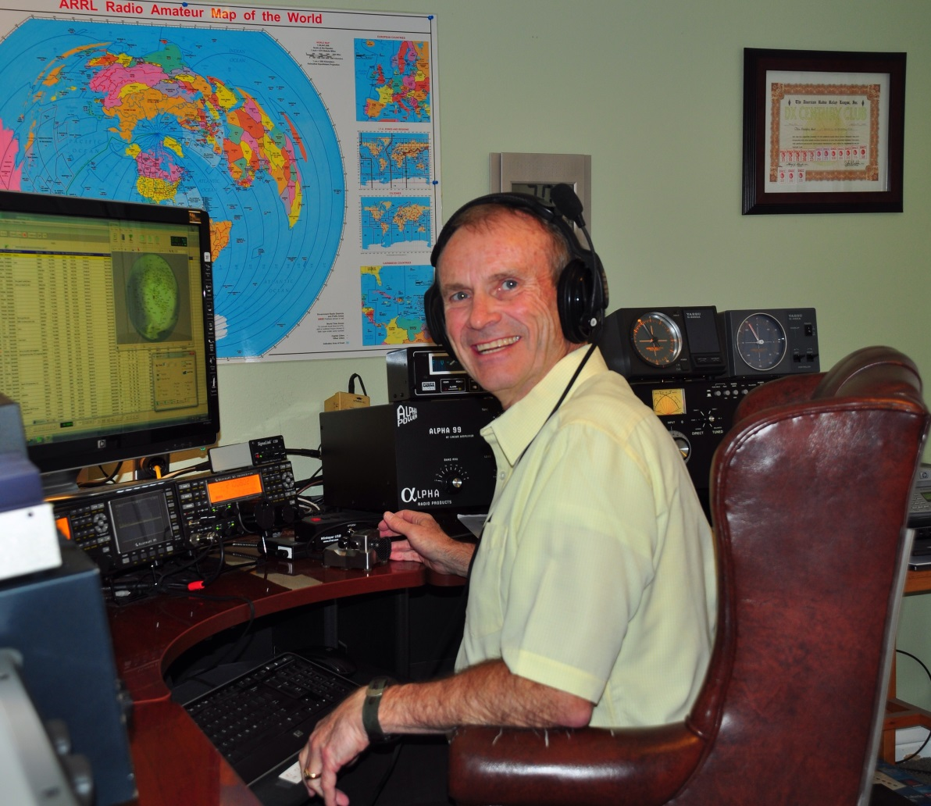
Bryce Anderson K7UA
Introduction to Modern DXing

Slide 2
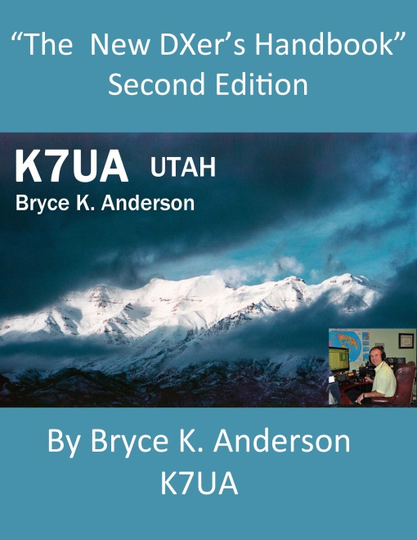
Bryce Anderson K7UA
DX University - Visalia 2016
First licensed in 1961 at age of 12. Amateur Extra, B.S. Electronic Engineering,
First Class Radiotelephone license since 1971.
Served in U.S. Army Signal Corps after college.
Operating awards: Various HF, VHF and satellite awards including:
DXCC Mixed Honor Roll (346 total/332 current), Eight band DXCC,
DXCC Challenge (2,200 level), QRP DXCC (268 countries),
Five band + 160M WAS, Triple Play WAS, WAZ, VUCC, etc.
Contesting awards: Too many to list, but I am especially proud of winning
first place for the W7 call area in the 2012 CQWW Phone DX Contest
(High Power Single Operator Assisted category) with only a 42 ft tower and a vertical.
Member and Past President of the Utah DX Association.
UDXA “DXer of the Year” 2008 and 2010 plus “Elmer of the Year” 2015.
Retired in 2014 after a 46 year long career in Information Technology,
the last ten of which were in IT Security.
Author of “The New DXer’s Handbook.”
An estimated 50,000 copies have been distributed free of charge worldwide. It is available in nine languages and as an audio book for blind amateurs through numerous foreign and domestic web sites including my own at www.k7ua.com.

Slide 3
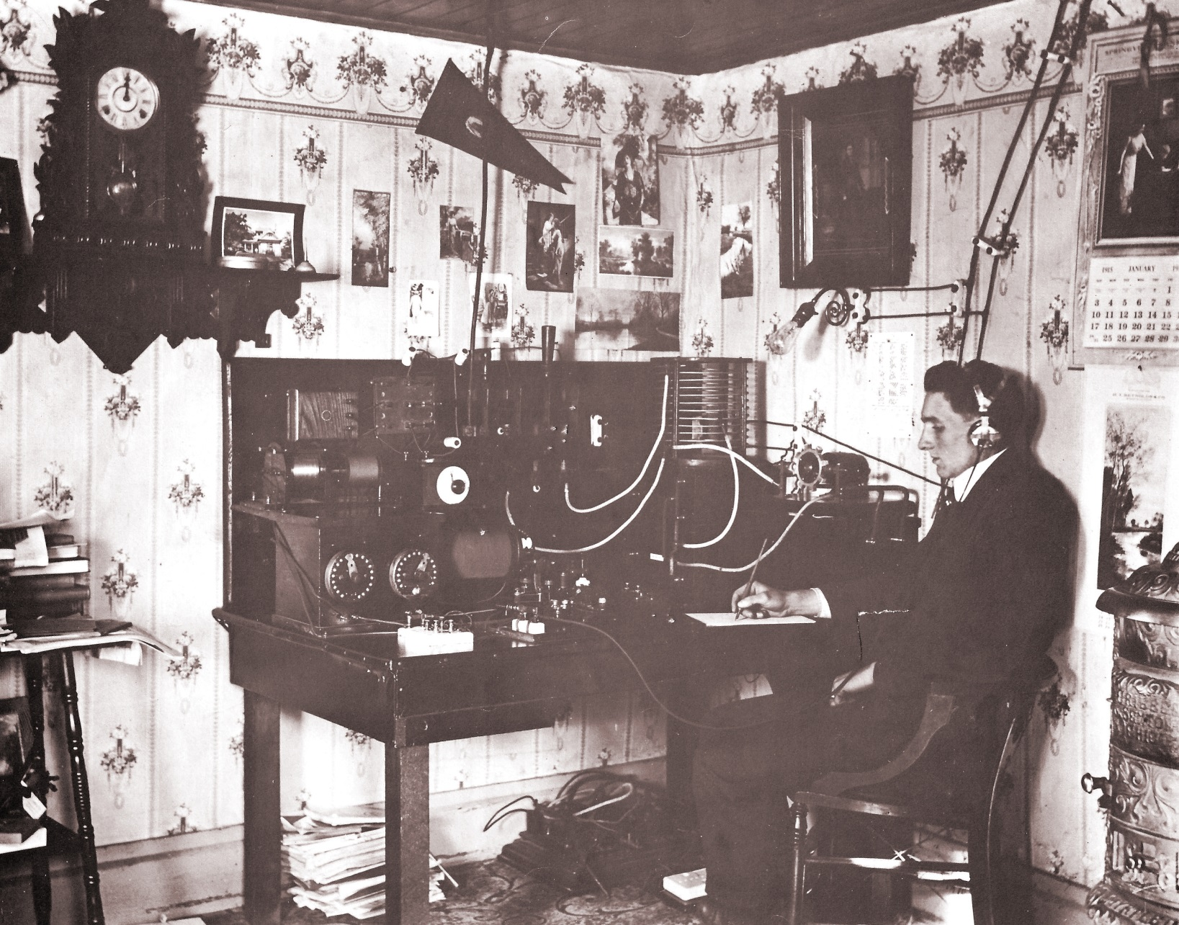

Slide 4
DXing has changed a lot in recent years.
However, it is still largely built on skills
and knowledge that were developed in the past.
We will be discussing some new modern ideas
mixed in with some old ones.
Don’t forget that no matter how high tech that you
get, that you still need to know basic DXing skills
to be successful.

Slide 5

There are many areas and levels of interest in ham radio.
DXing is a specialized area of the hobby.
It can be extremely competitive or just of casual interest
to the operator.
One has to determine their expectations and proceed accordingly.

Slide 6
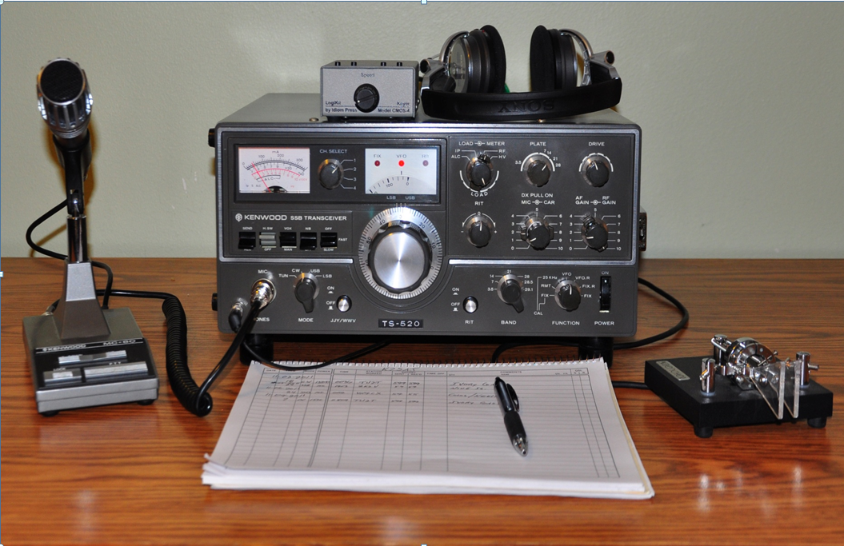
You can work DX with any station.
Even a basic transceiver and a simple wire antenna
can get results, but you have to be realistic with your expectations.

Slide 7
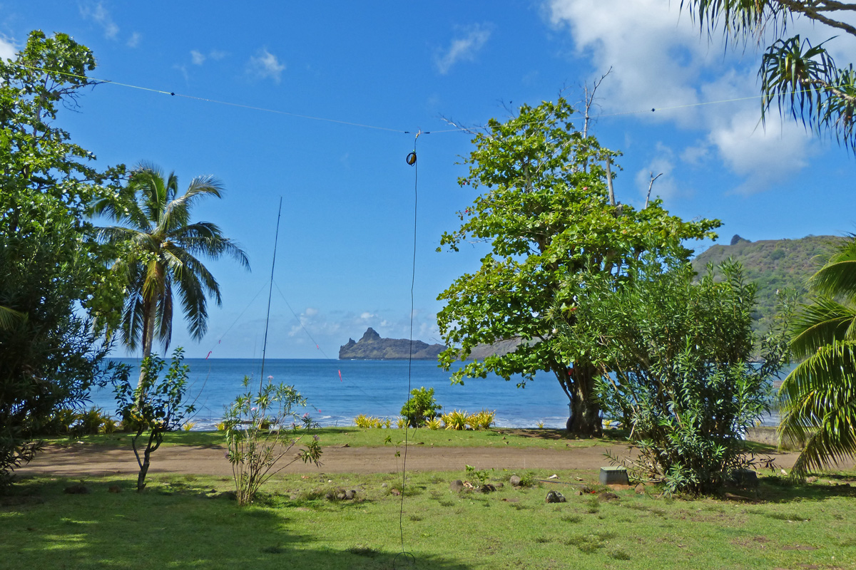
Simple antennas at the TX7G expedition in the Marquesas Islands netted over 27K QSOs!

Slide 8
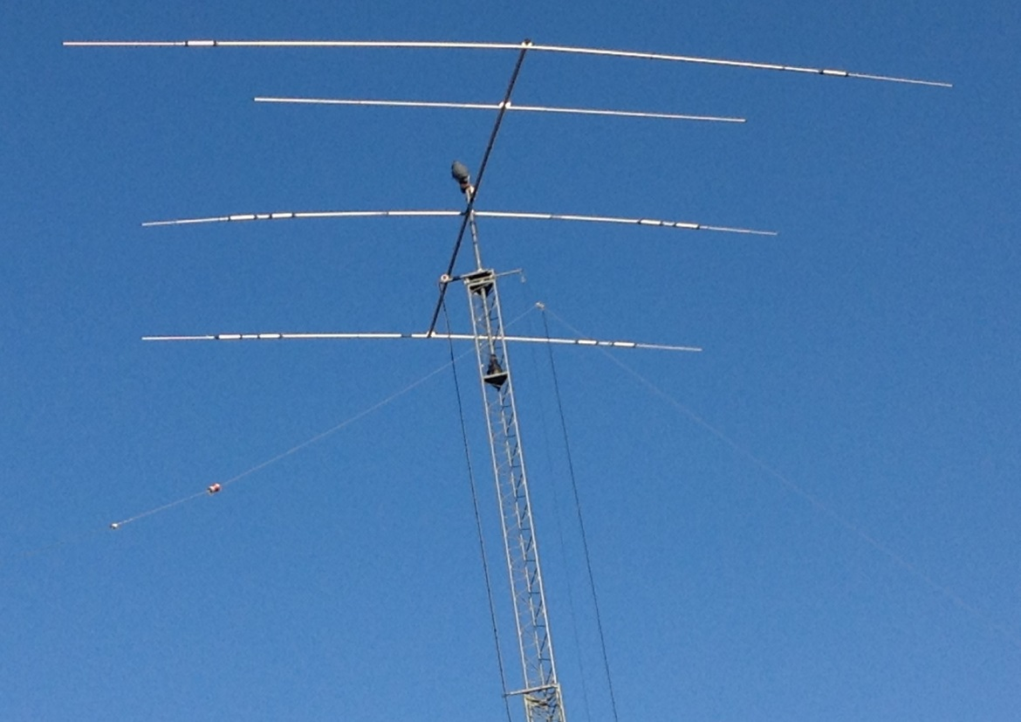
Having a beam antenna puts you in a class way beyond a vertical or wire dipole. However, a modern DXing station needs to have capability for the so called WARC bands. They include 30, 17 and 12 meters. They were approved for amateur use in 1979. Some antenna manufacturers still don’t include them on their antennas.
Come on! The idea of a “tri-bander” is obsolete!

Slide 9
A caveat.
DXers and Contesters have similar, but not identical interests.
Contests are not held on the 12, 17 and 30 meter bands.
Therefore, contesters may not care much about the WARC bands and not put their efforts into great antennas for them.
That’s ok. Just two specialties within the sport.

Slide 10
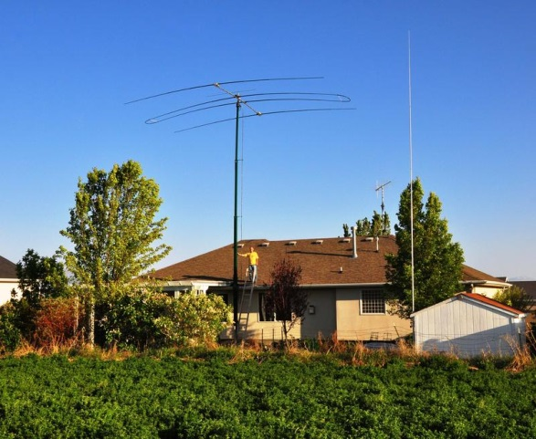
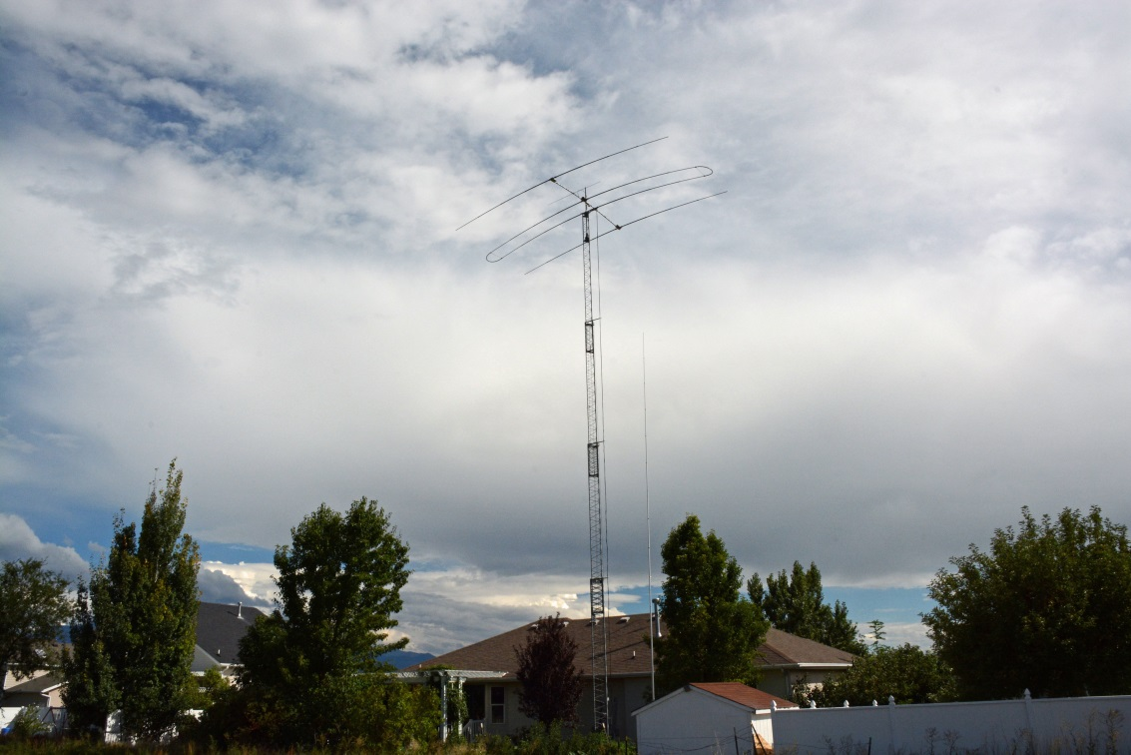
After a period of 20 years of inactivity, I got back into DXing.
I had expectations of being moderately competitive. This is the modern antenna that
I chose to include full WARC frequency coverage. I have kept upgrading my system for the
past ten years. There are other great options available, but do not disregard WARC!
Those bands are too valuable to ignore.

Slide 11
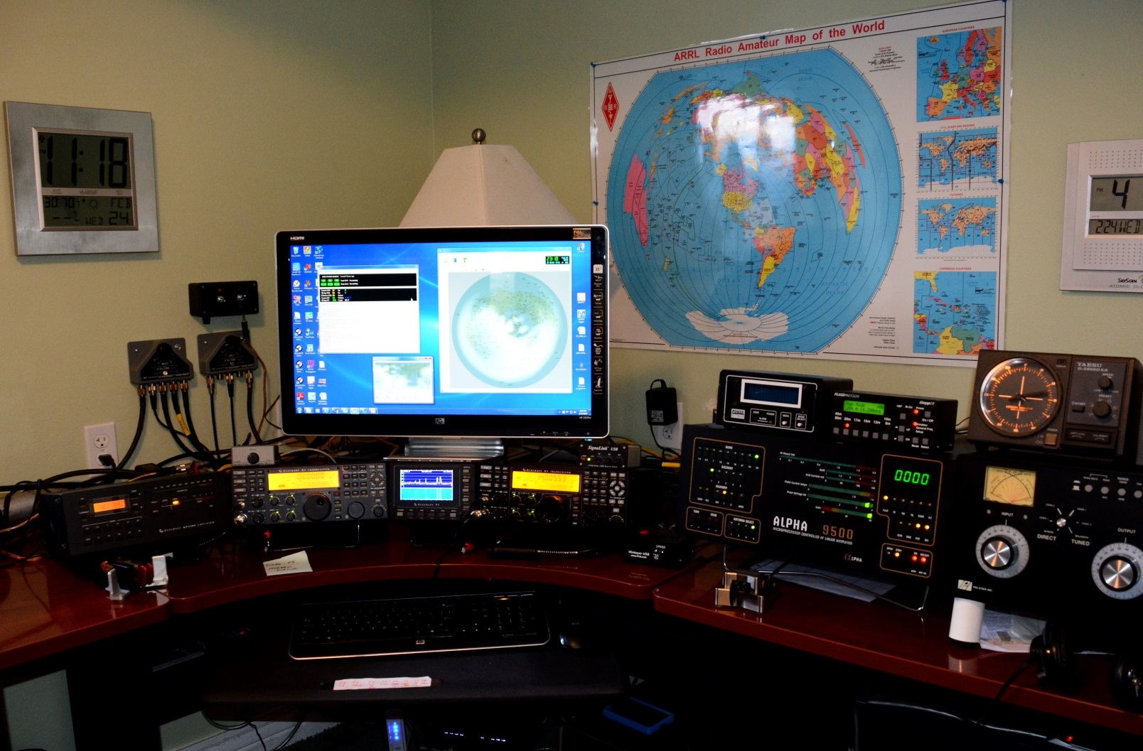
This is my modern station at K7UA. A typical setup for a serious DXer.
I highly recommend a transceiver with a sub-receiver and also having a pan-adapter.
They are both incredibly useful to a modern DXer who has high performance expectations.

Slide 12
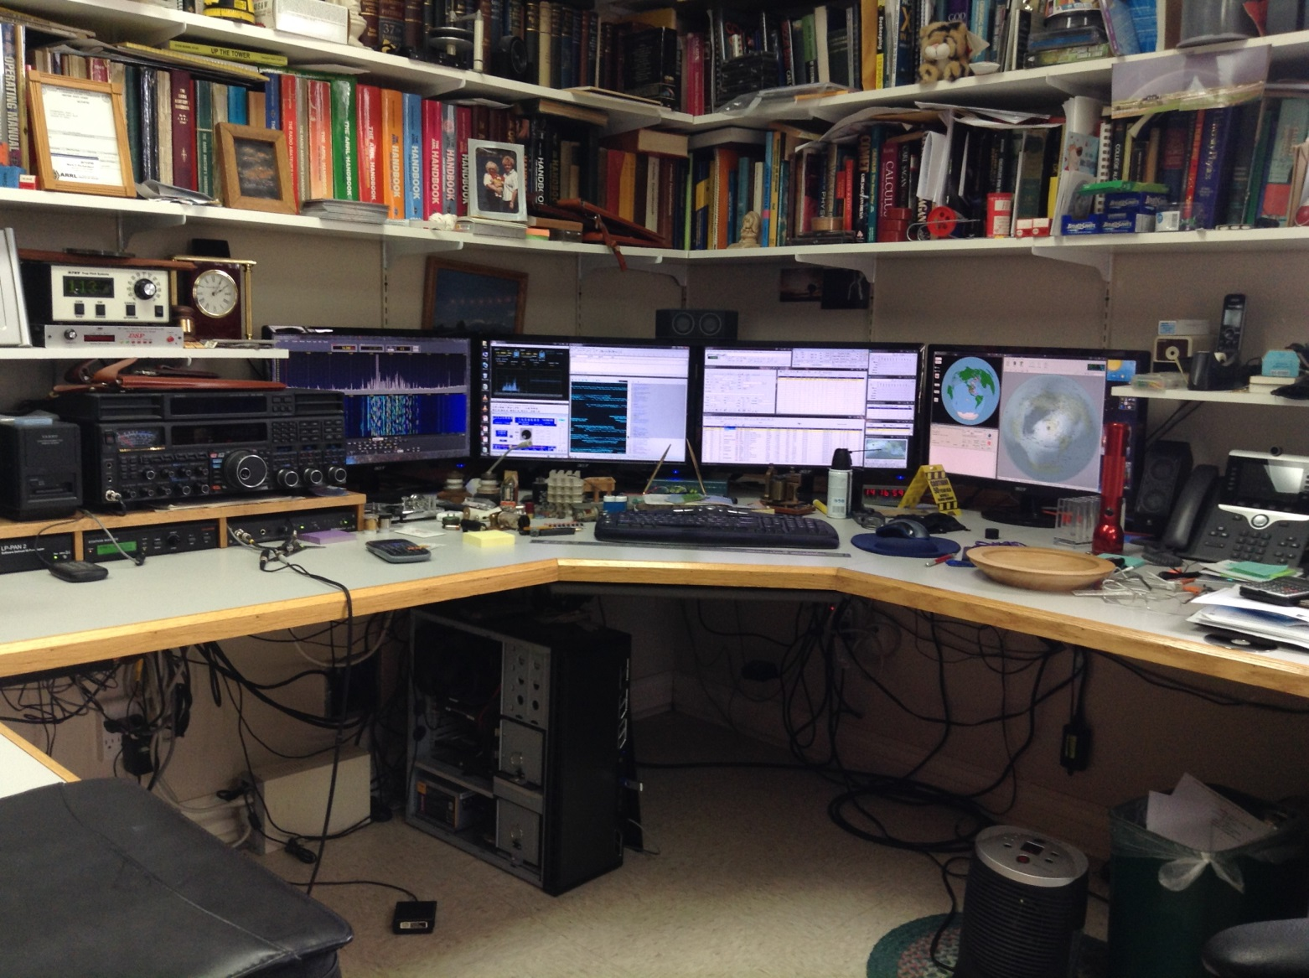
The excellent station of W7HPW. A station worthy of top rung performance expectations.

Slide 13
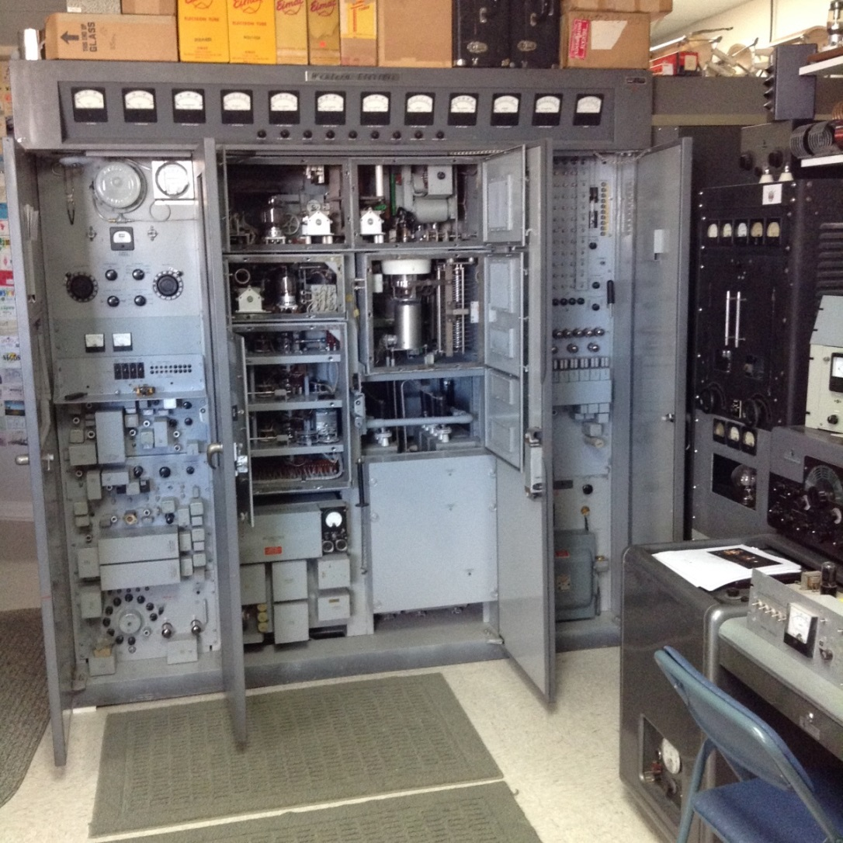
Western Electric amplifier at W7HPW

Slide 14
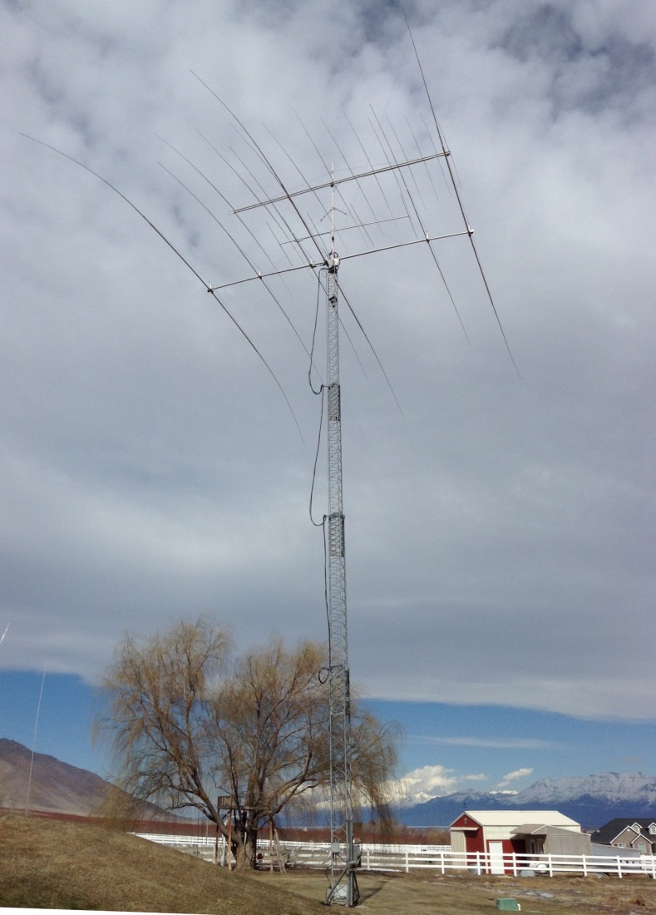
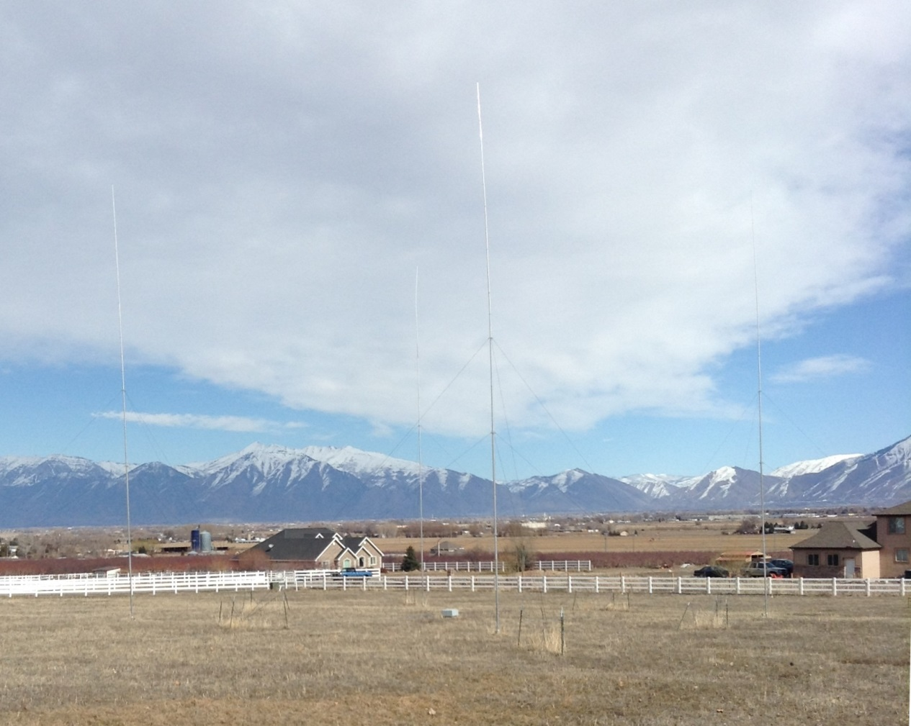
Big beams and 80 M four square antennas at W7HPW

Slide 15
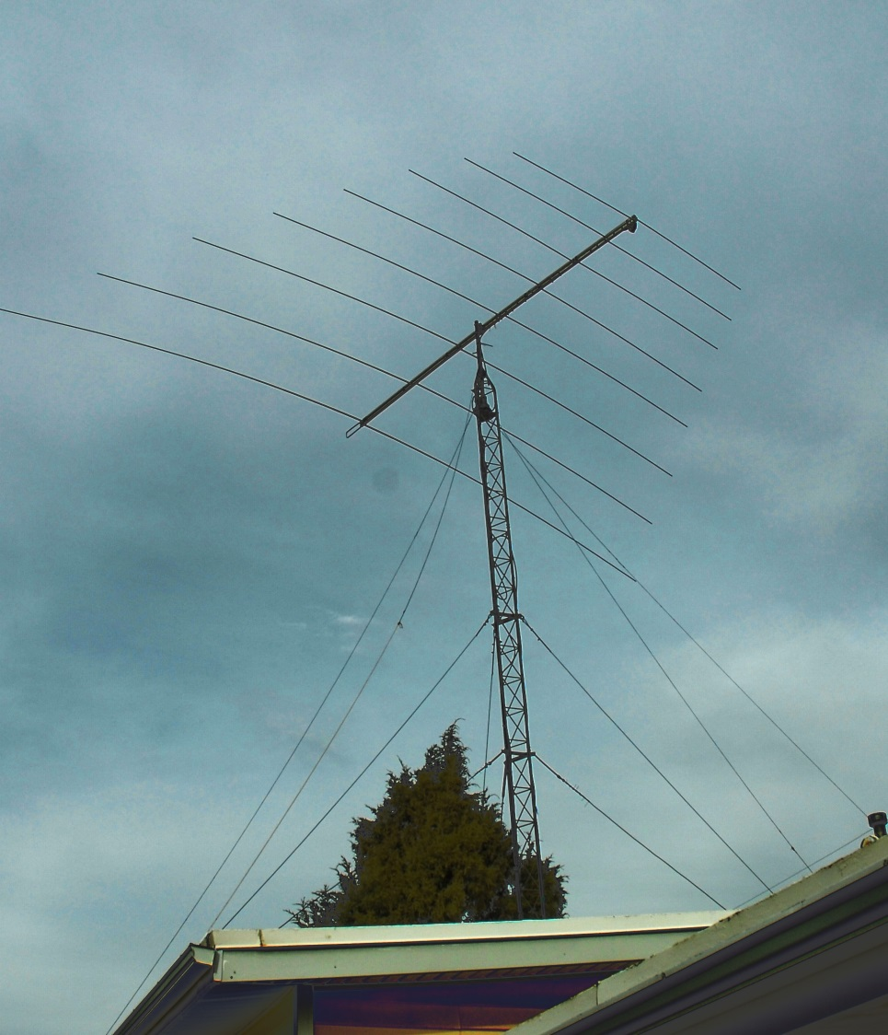
The military loves Log Periodic antennas because of their frequency agility.
They make great multiband ham antennas. This is a Tennadyne T8 at AK7O.

Slide 16
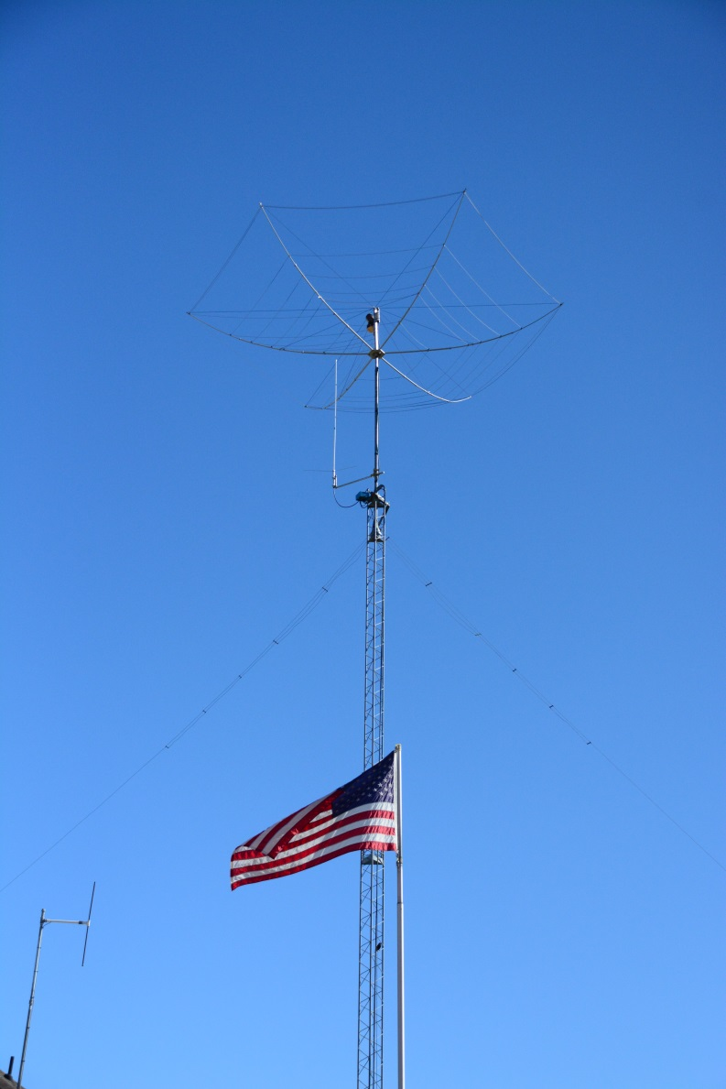
Hex Beams are another popular choice offering WARC coverage.

Slide 17
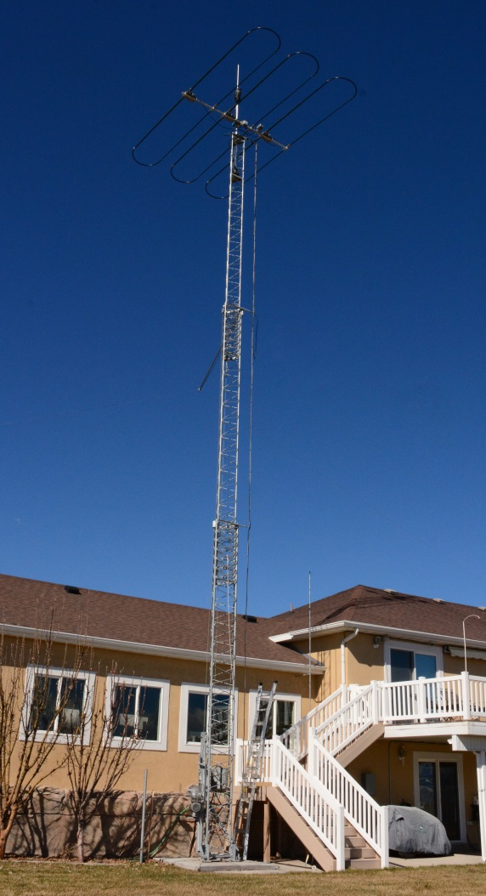
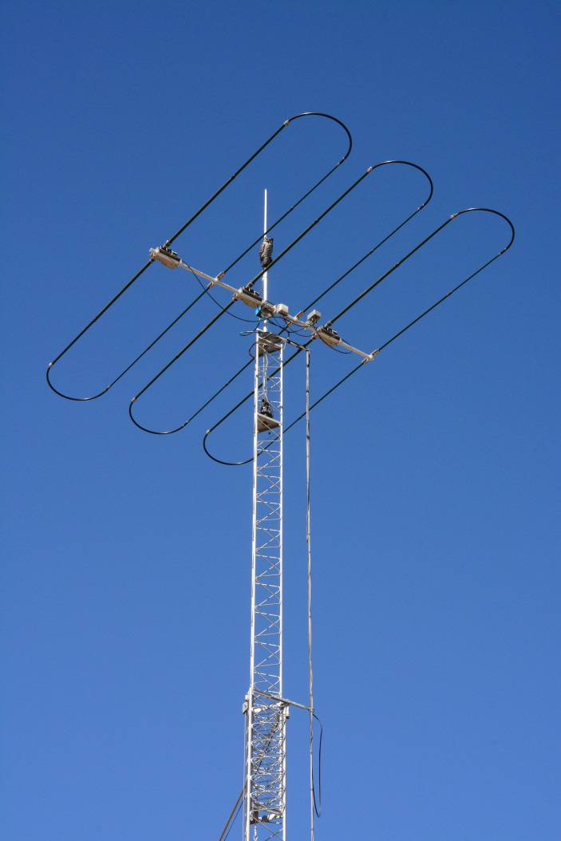
AK7PZ has this cool antenna suitable for cramped space, the SteppIR DB11.
The elements are one half size in length.

Slide 18
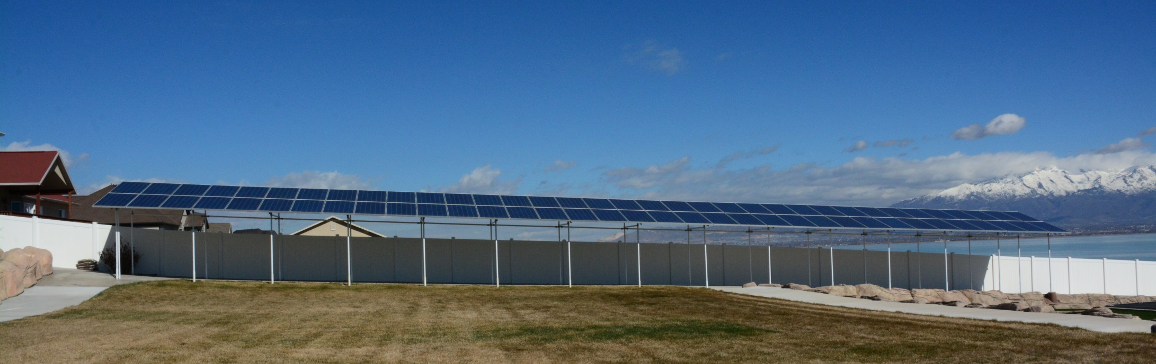
AK7PZ can also power his entire home with solar energy!

Slide 19

Higher is usually better with antennas, but how high is high enough.
Once again, remember your expectations. For significant low angle radiation a horizontal
antenna needs to be at least one half wave length high. Those super low take off angles
at 2 degrees may or may not be helpful at your QTH. I live in the mountains!

Slide 20
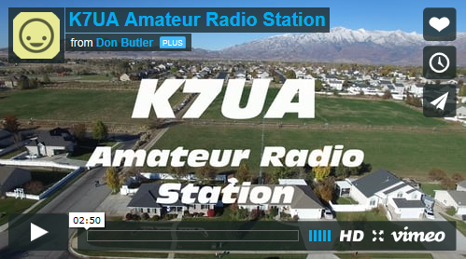
This is my best direction. There are mountains in the way everywhere!

Slide 21
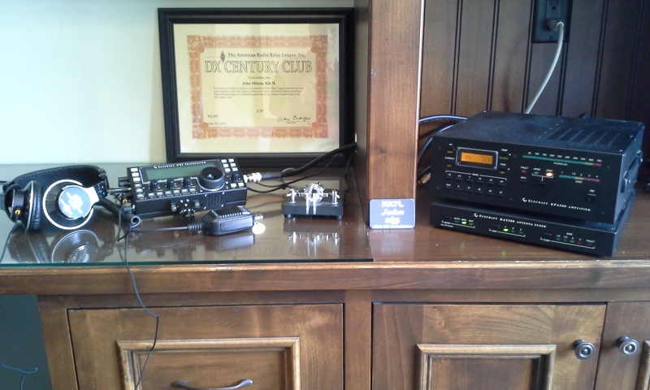
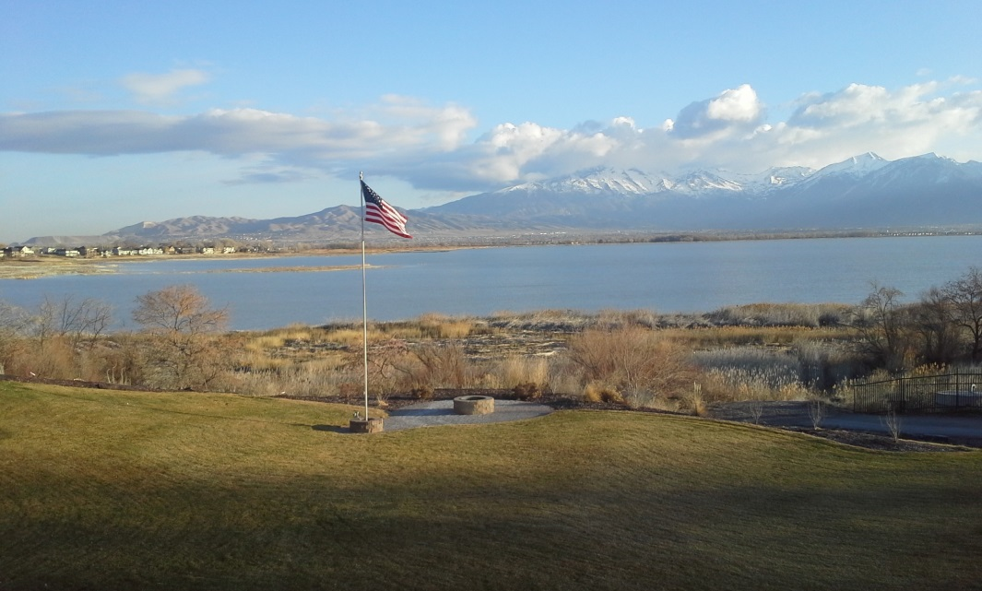
HOA restrictions? You could try an attic wire antenna, but check out this stealthy station! Here is the modern, effective HOA beater station of John, KK7L. He uses an Elecraft KX-3 QRP rig driving an Elecraft KPA500 amp to only 180 watts with a 24 ft flag pole antenna with 33 radials. He has worked 165 countries in only two years!

Slide 22
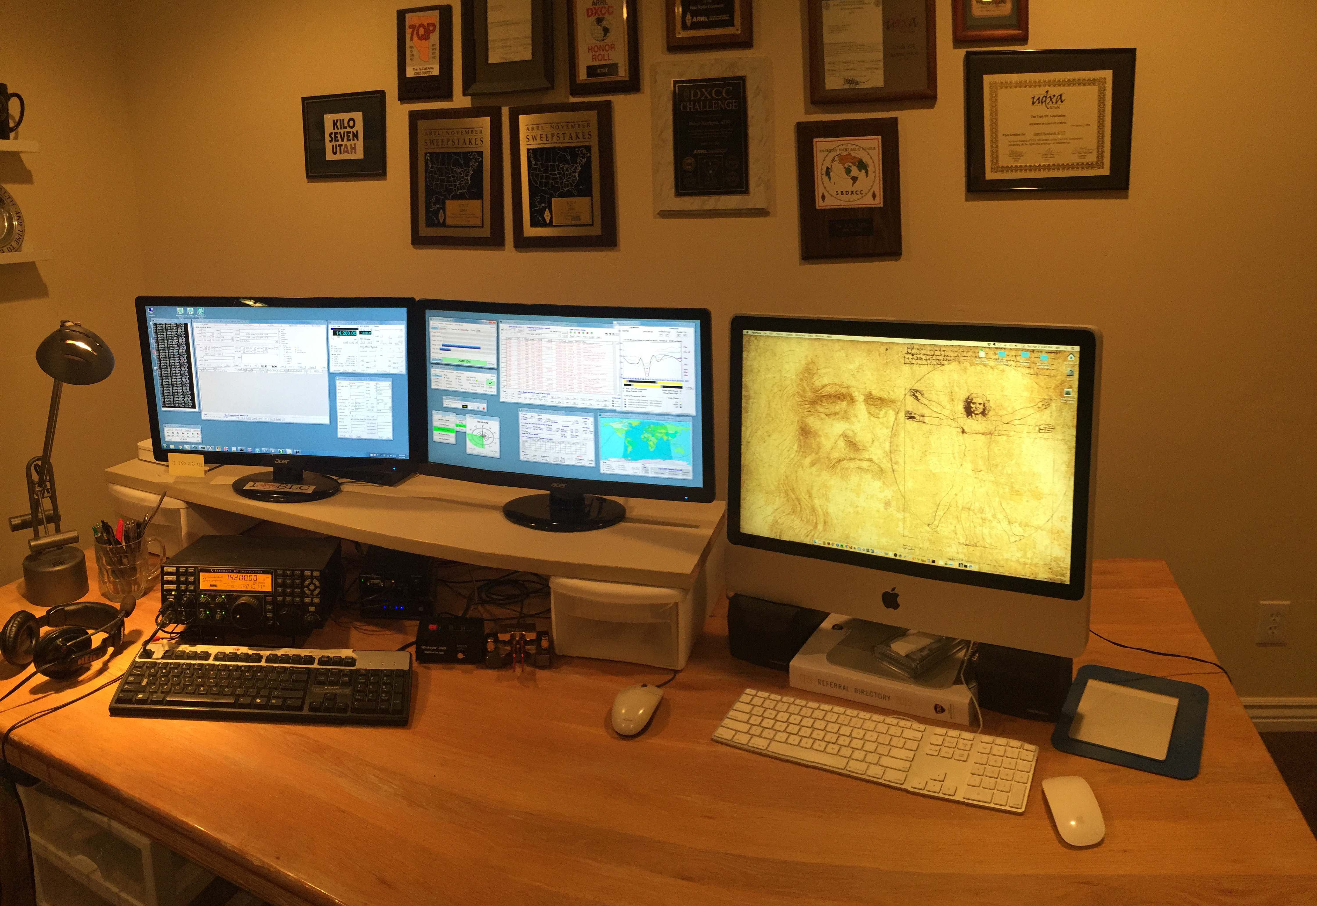
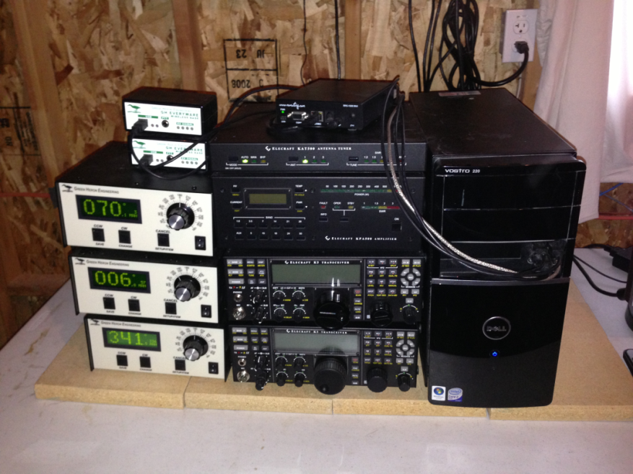
It takes effort, but operation via a remote station is now common.
Here is the excellent remote station of K7UT.

Slide 23
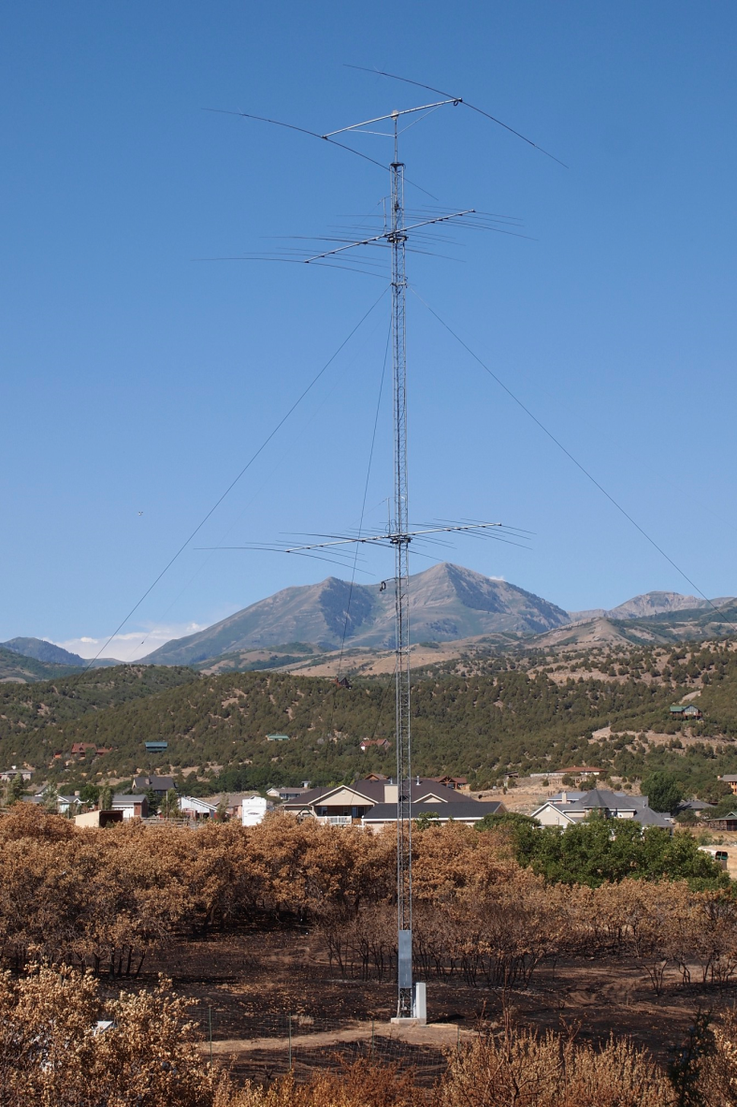
K7UT operates from a townhome, but has these great antennas from the 100 ft. tower at his remote station!

Slide 24
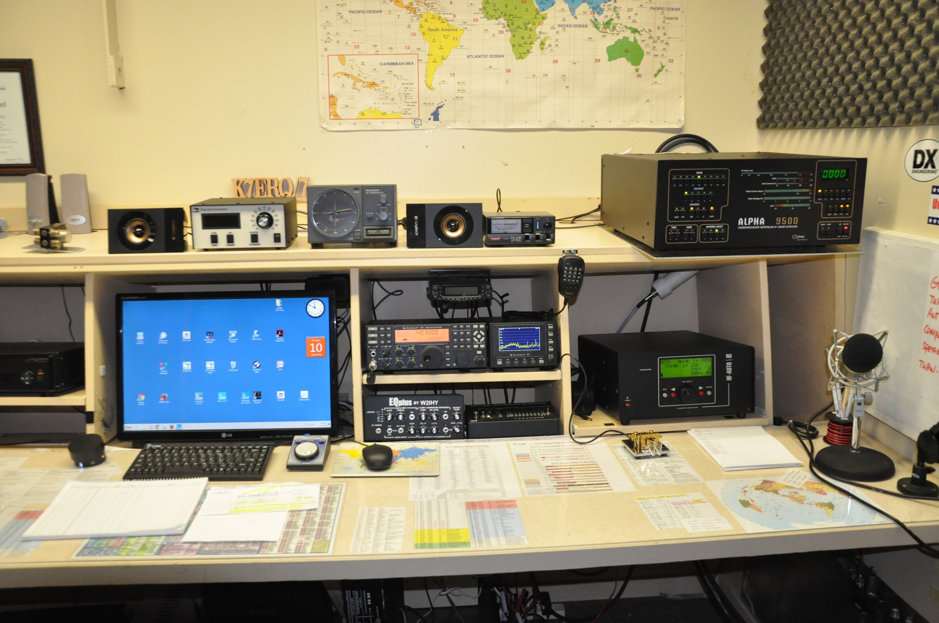
The remote station of K7ERQ.

Slide 25
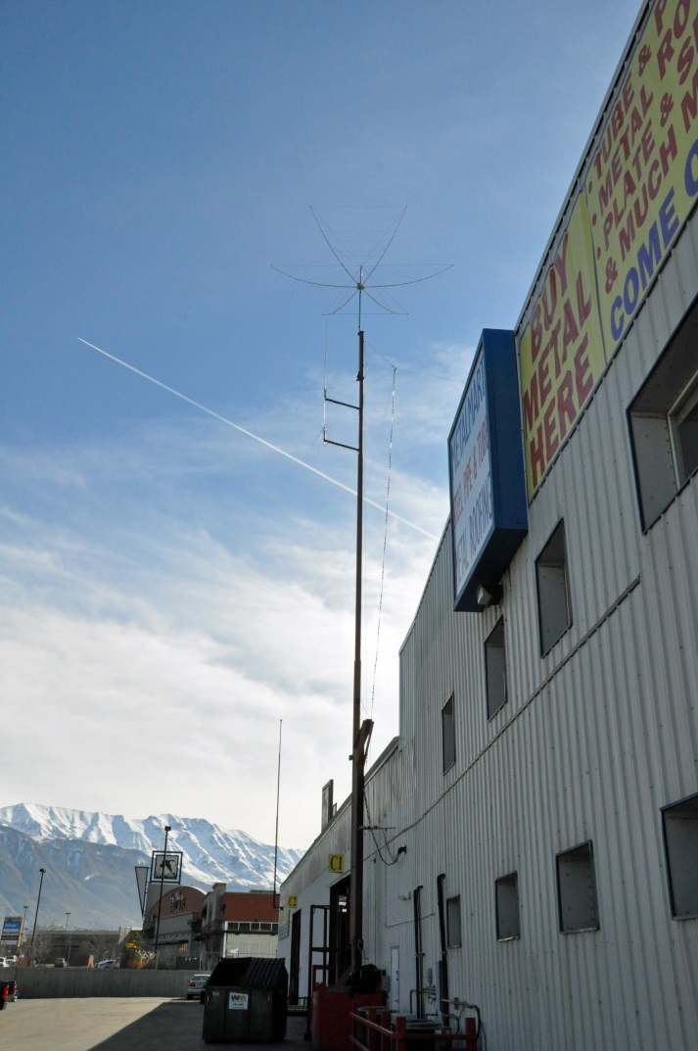
K7ERQ uses an Elecraft K3/0 Mini at his control location to run the remote
station at his business miles away. Here is his antenna system.

Slide 26
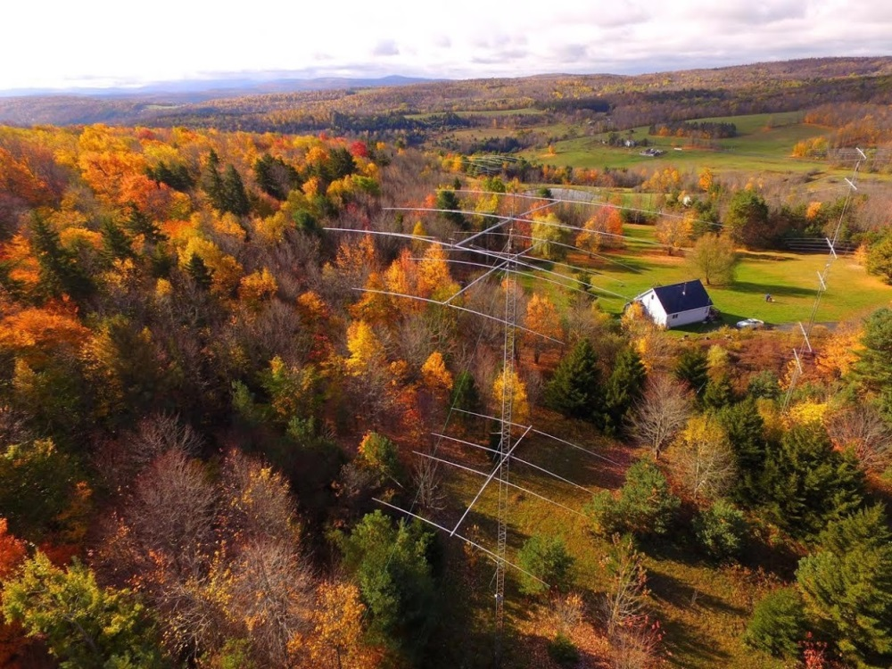
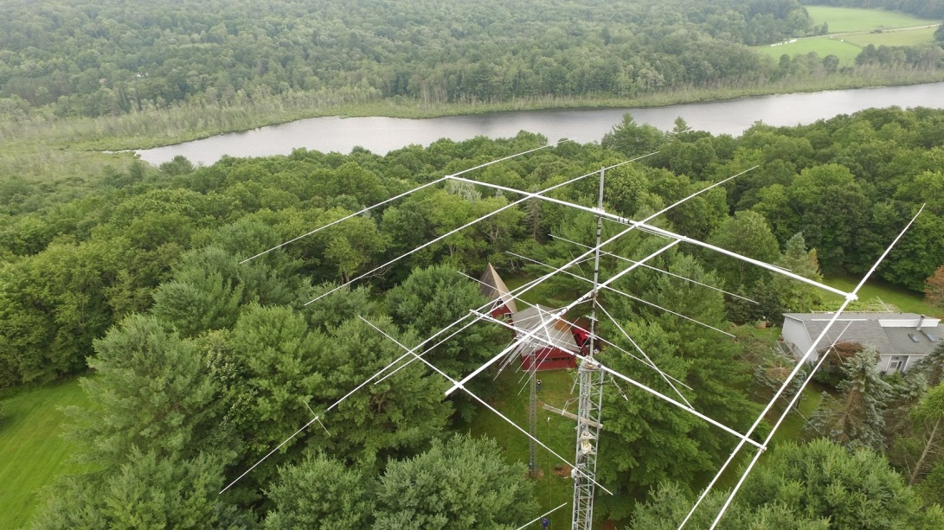
Another modern option is Remote Ham Radio! Operate fantastic stations from
anywhere. Talk about super stations! They are available on a subscription basis.
See remotehamradio.com for details. These pictures are used with their permission.

Slide 27
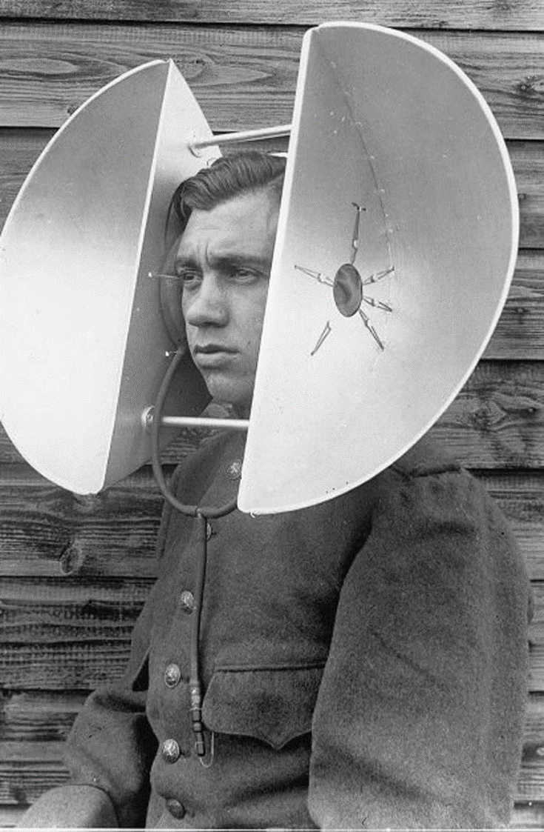
Listening will always be the key element in DXing!

Slide 28
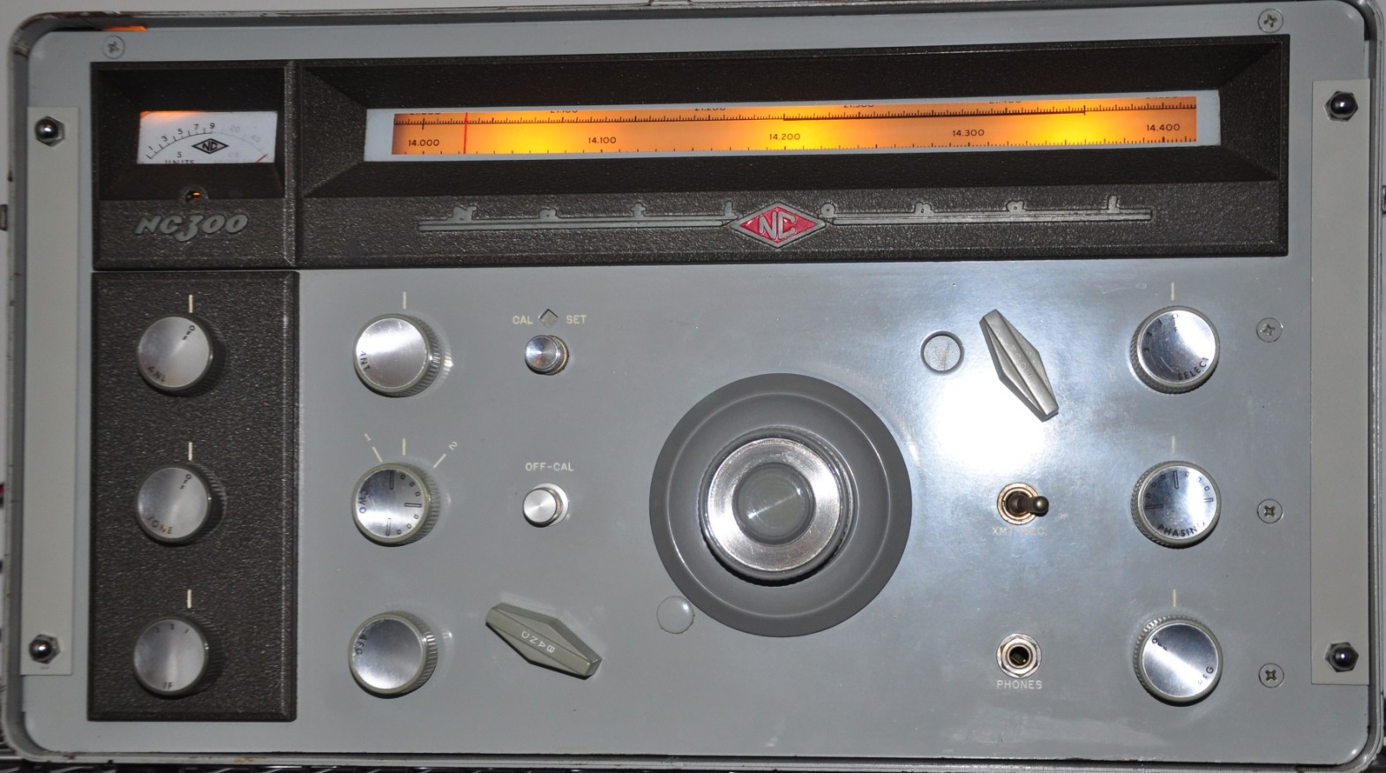
How do I do it? Start tuning on one end of the band and see what you can hear!

Slide 29
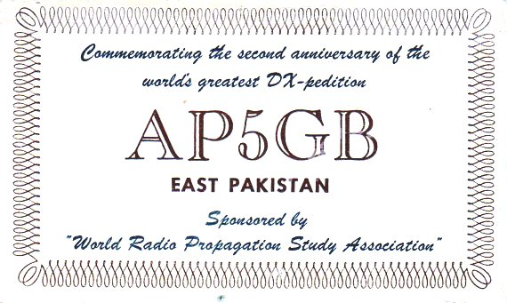
Hear what? How about something like this!

Slide 30
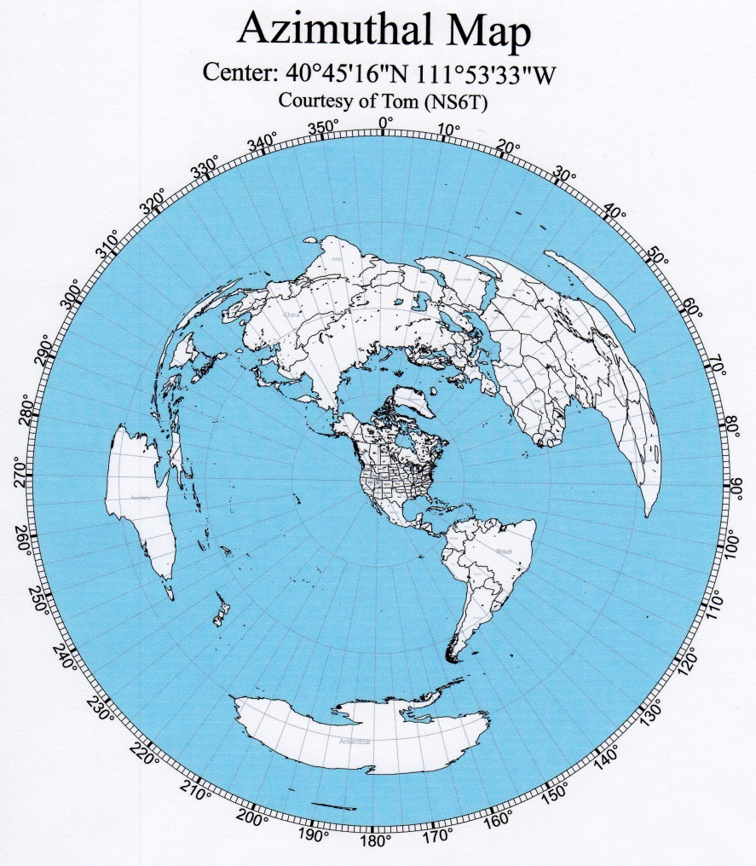
If you have a beam then you need an accurate azimuth map to aim your antenna.
You can use your computer to generate one unique for your QTH for free courtesy of Tom, NS6T at
http//ns6t.net/azimuth/azimuth.htm

Slide 31
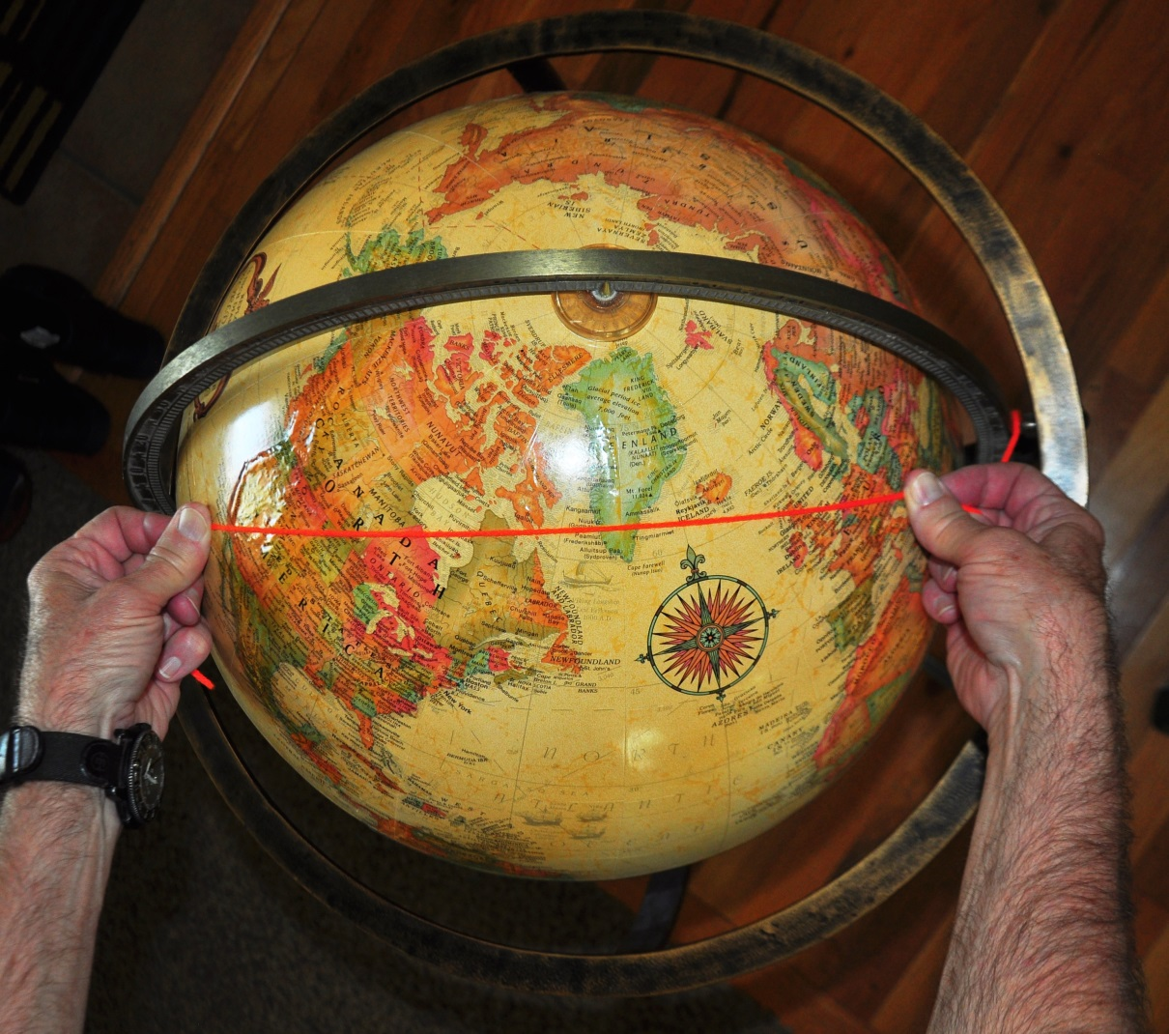
Incidentally, if you are new to DXing,
the true directions to distant locations may not be obvious to you.
W7 to Europe illustrated.

Slide 32


W7 to South Africa. Surprisingly due East.
Use your computer to learn how to accurately aim your beam!

Slide 33
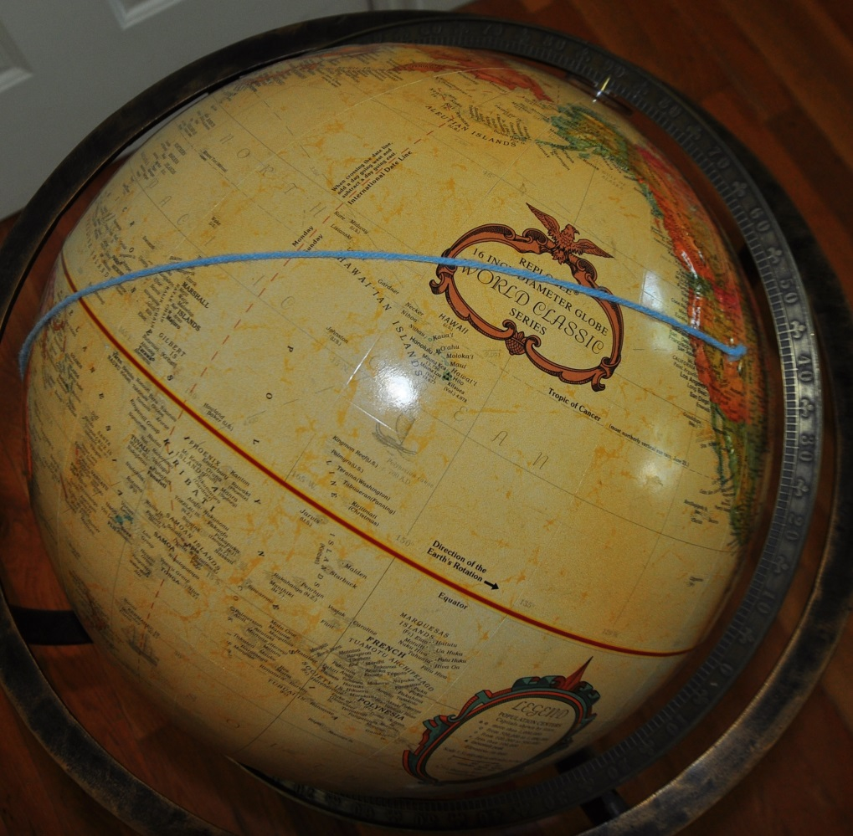
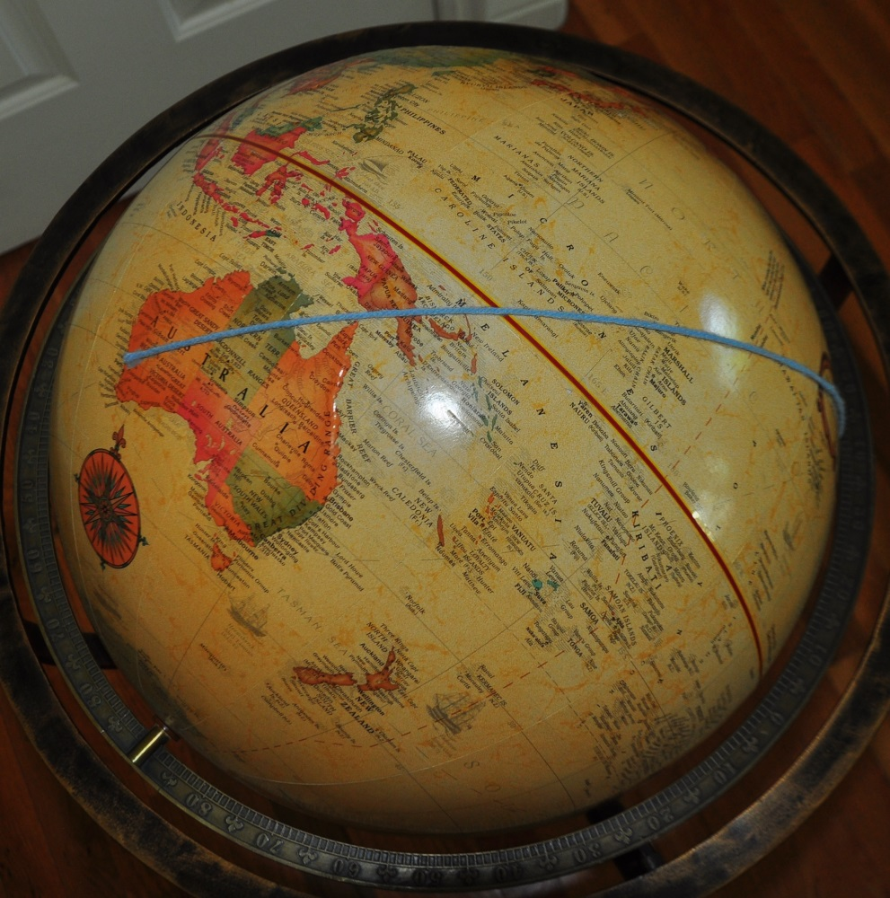
W7 to Western Australia. Again, surprisingly due West.

Slide 34
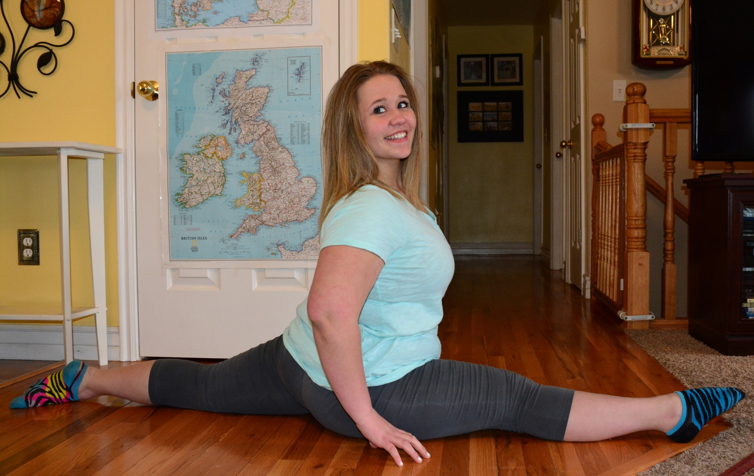
Earlier I mentioned subreceivers and panadapters. Why are they useful?
To work split!

Slide 35
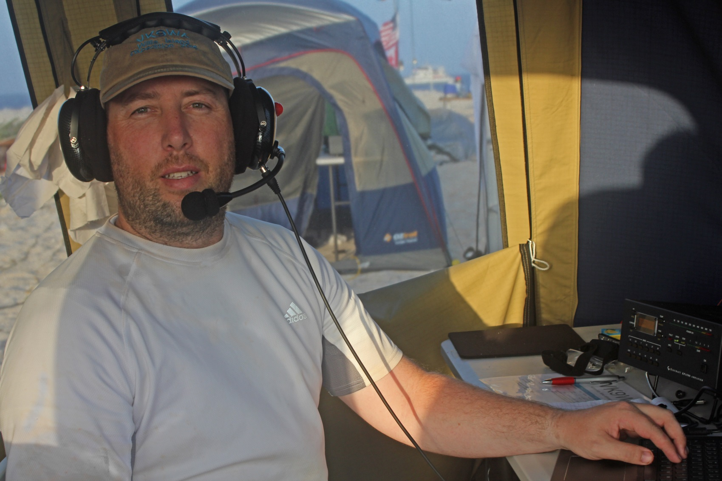
Things are easy if you find a DX station calling CQ and you and a couple of others answer them. N7SMI operating VK9WA.

Slide 36
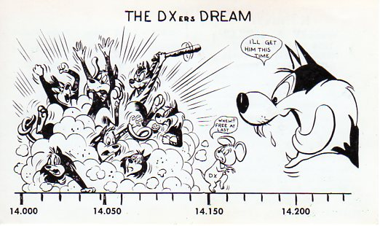
However, it quickly turns into this!

Slide 37
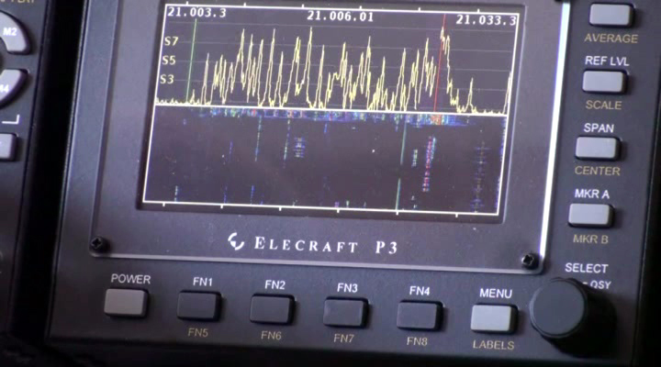
Here is another way of looking at it.

Slide 38
The only chance a DX station has to hear anybody clearly is to listen on a different
frequency than they are transmitting on!

Slide 39
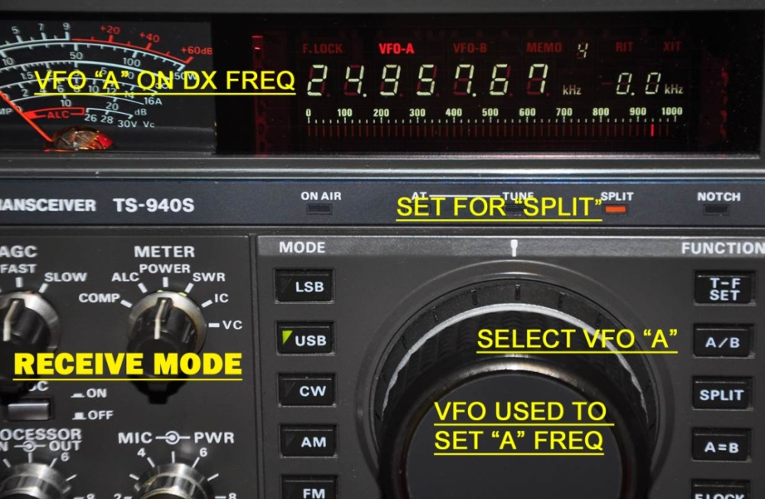
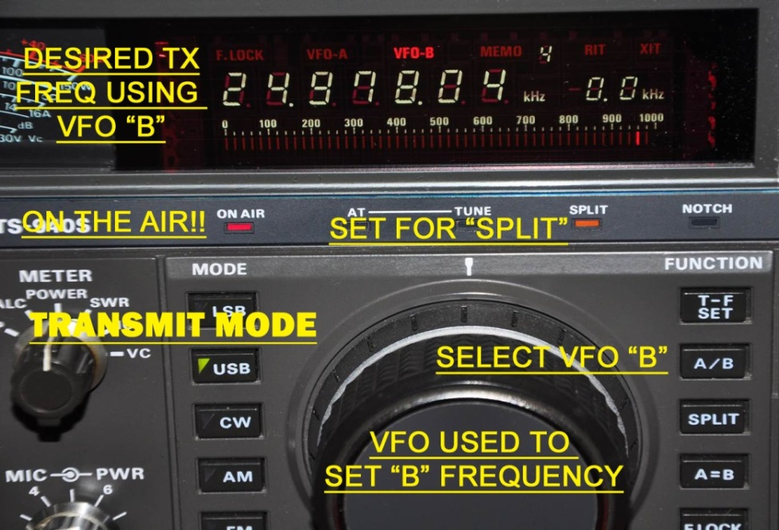
Listen to DX on “A”
Transmit to DX on “B”

Slide 40
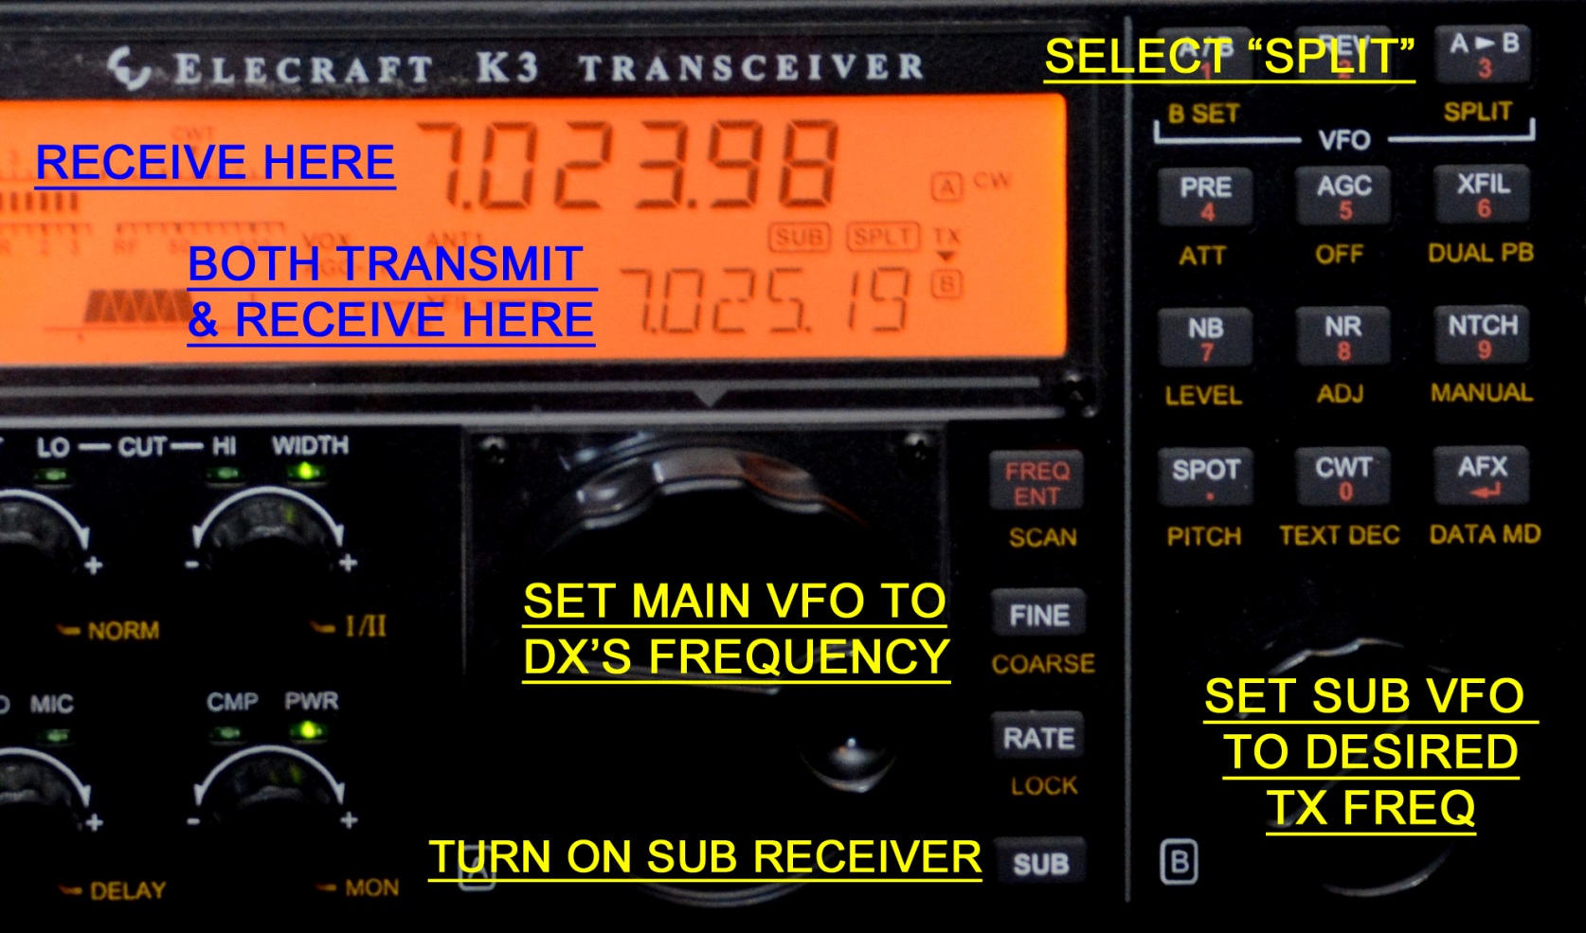
To be heard in the crowd you need to transmit where the DX station
is actually listening! Enter the subreceiver!

Slide 41
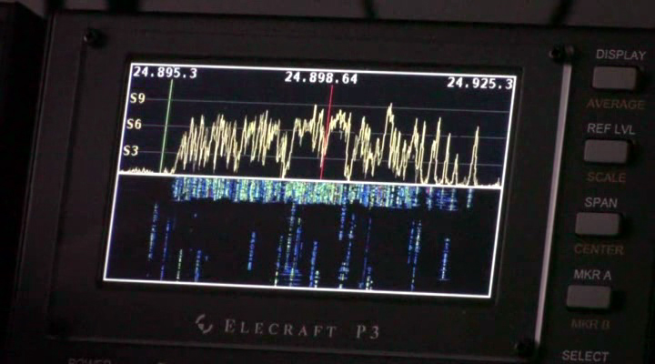
Panadapters can also help you find the station that makes it through the din.
This is an Elecraft P3 view of the pileup calling TX7G as viewed at N5LZ.

Slide 42
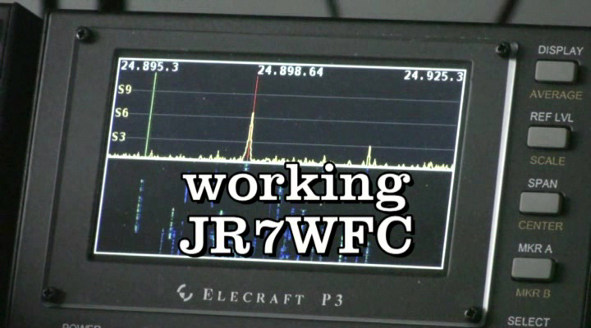
This is how it should look when one DXer responds correctly to his call.
Often other stations keep calling, but you can at least usually find
the correct station’s signal in there.
My kudos to the Japanese stations for their discipline!!!

Slide 43
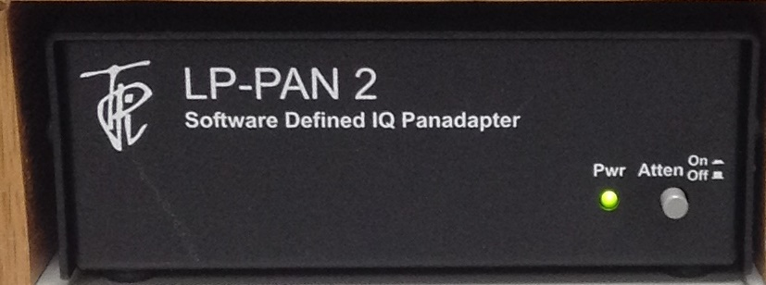
There are other excellent panadapters available.
SDR solutions use your computer’s processing power and monitor,
along with a software defined receiver IF interface.
You may need a better than average computer to run several applications including your panadapter all at once, but you will get a large monitor sized display automatically.

Slide 44
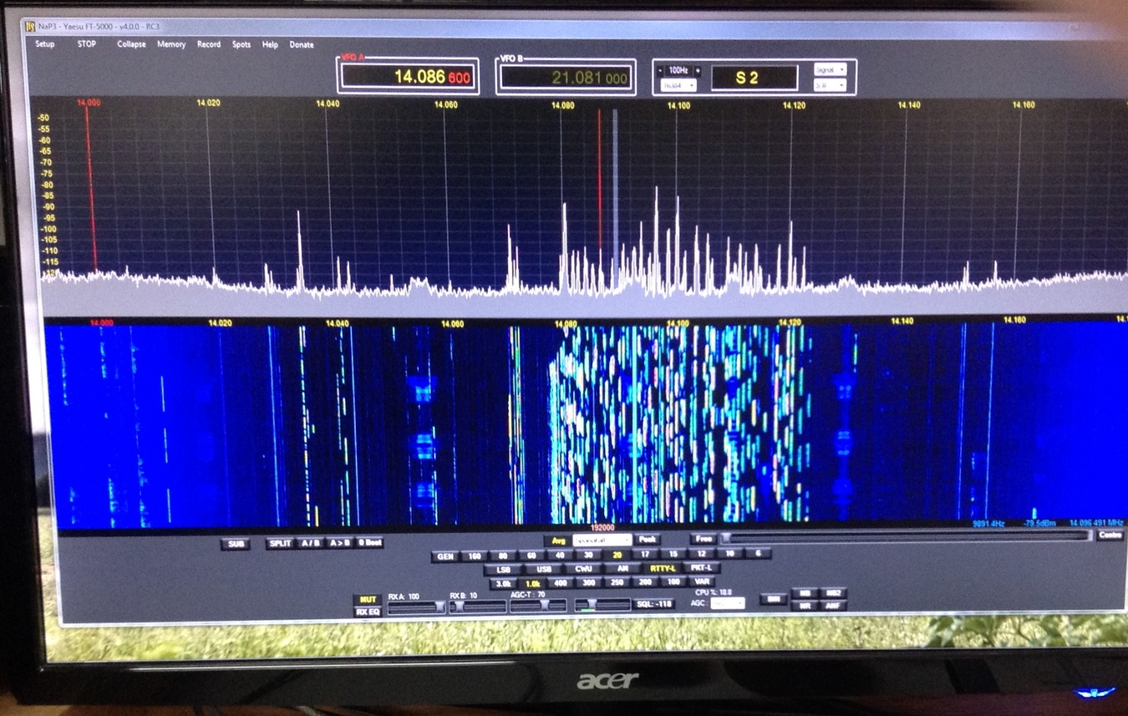
This is W7HPW’s panadapter.

Slide 45
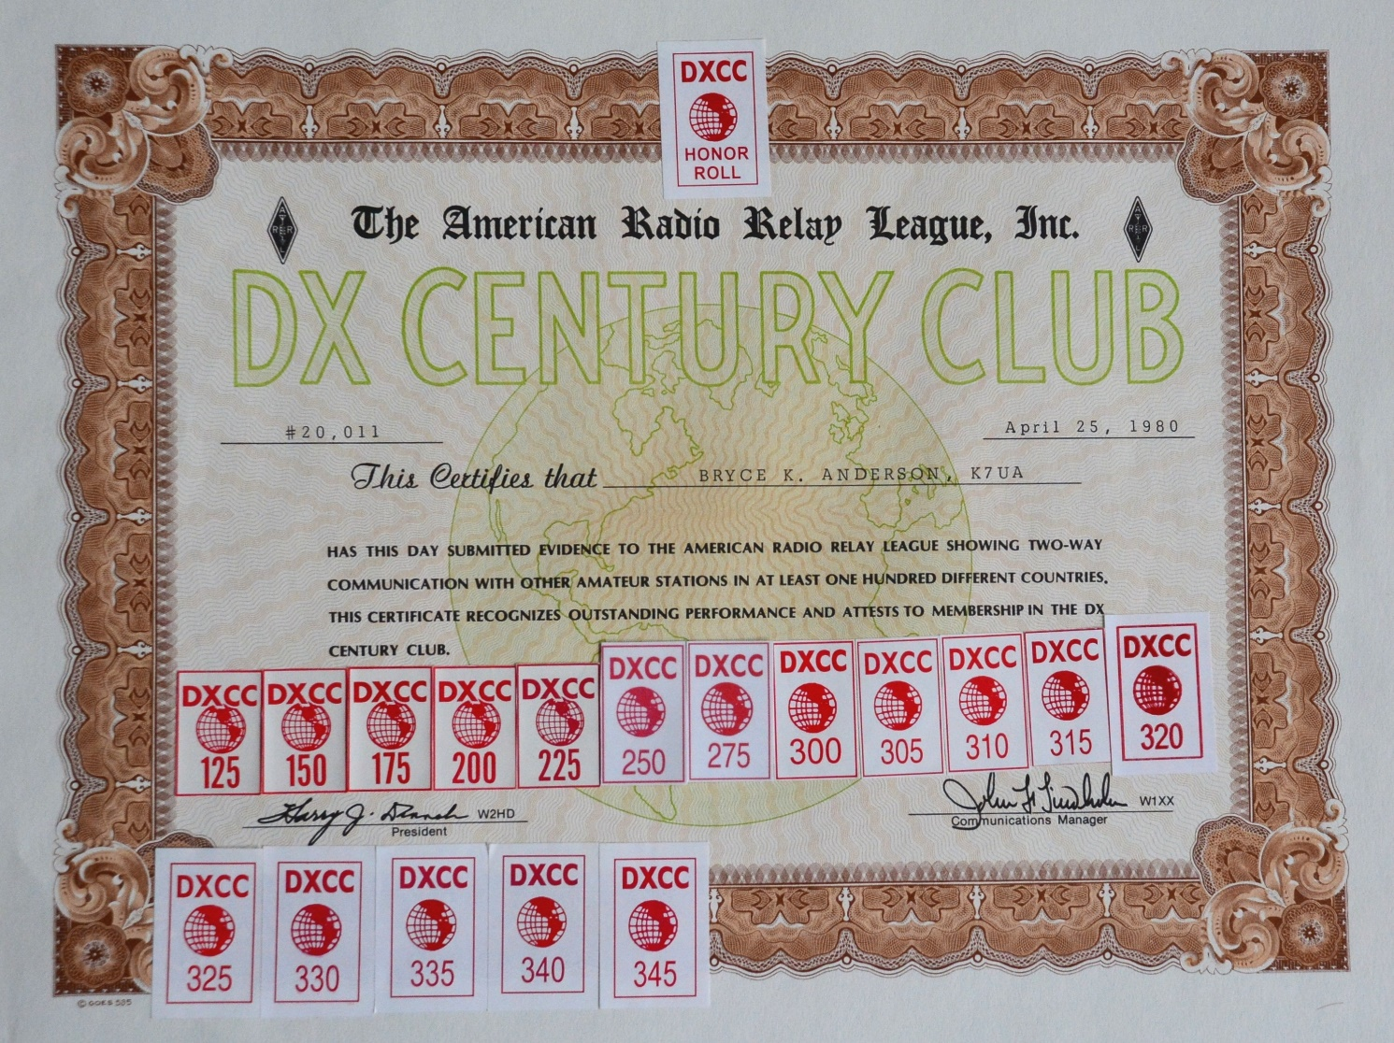
Most DXers are interested in operating awards like these:

Slide 46
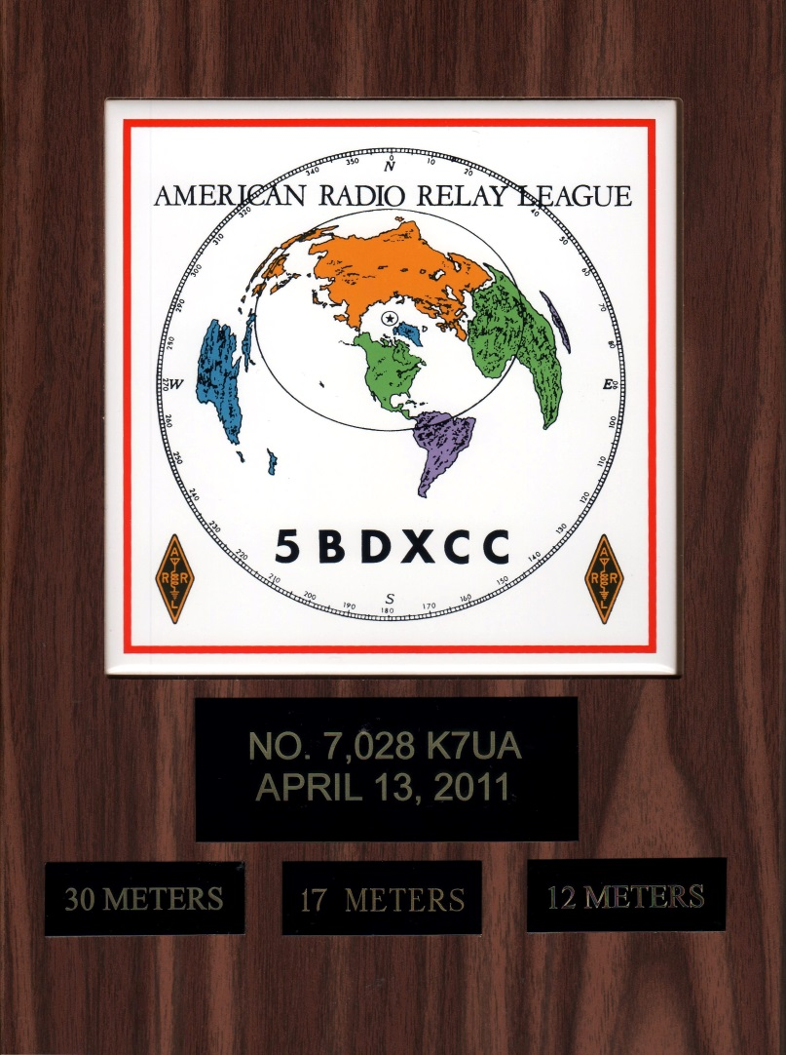
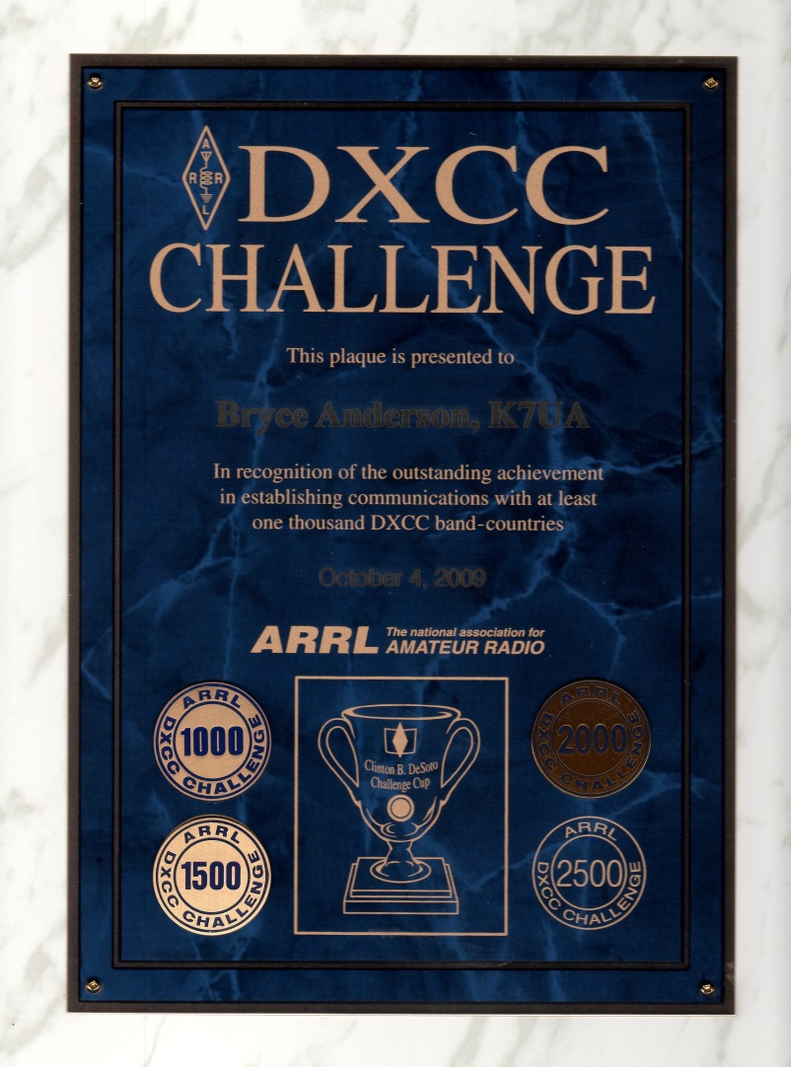

Slide 47
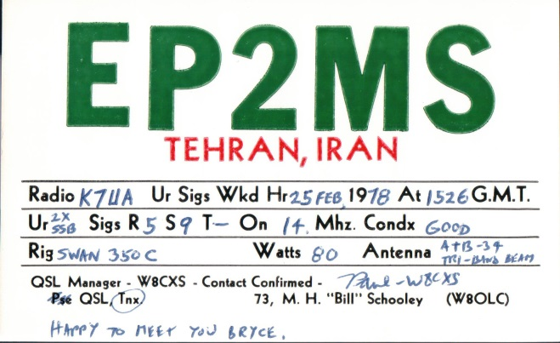





Those awards require proof of the contacts to earn them.
The old way has been paper QSL cards.
They are still important, but we will talk about more modern
solutions later in the presentation.

Slide 48

I spent my entire career in IT. I’m retired now and I’m sick to death of keeping up with IT technology. None the less, YOU ABSOLUTELY NEED A DECENT COMPUTER in a modern ham station.

Slide 49

Use your computer for the Spotting Cluster Network.

Slide 50

You need computer logging software!

Slide 51



So why do I need a computer logging program?
So that you can take advantage of the terrific resources that are
available like the ARRL’s Log Book of the World, Club Log
and to track your own awards progress. We will discuss each of these.

Slide 52



Remember those confirmations that you need for operating awards?
The paper QSL cards can really mount up and be a pain to deal with!

Slide 53
While paper QSLs certainly work, they are slow and expensive to exchange. Luckily there is a modern alternative! The ARRL has developed a fantastic modern electronic confirmation process called Log Book of the World (LoTW) to improve the whole process.

Slide 54

You can use your logging software to automatically upload your QSO information
to LoTW and let it match up certified confirmations for you. Here is a sample of
my DXCC records on LoTW.

Slide 55

You can just as easily download LoTW confirmations into your logging software
to help you keep track of your confirmations. LoTW isn’t just for DXCC. It can
also be used for all of the ARRL’s awards like WAS and for CQ Magazine’s WPX award.

Slide 56


Note LoTW

Slide 57

There is another modern electronic QSL confirmation site called eQSL.
It is different in that it sends electronic images similar to a paper QSL card.
It also makes no attempt to match up QSOs like LoTW does. The ARRL does
not accept eQSL for its awards, but CQ Magazine does. You can again easily
upload and download eQSLs with your logging software.

Slide 58

Many consider CQ Magazine’s Worked All Zones award
to be more difficult to achieve than DXCC.

Slide 59
Club Log – a very cool resource!
Once again you can upload your log data from your
logging software to obtain a wide variety
of extremely useful services!

Slide 60

It took me two years to enter all of my old logs back to 1961
into my logging software. My first upload to Club Log found
a DXCC entity that I had confirmed but didn’t know it!

Slide 61

Use Club Log to track your achievements like DXCC totals and band slots
for the DXCC Challenge.

Slide 62

Compete within your local club.

Slide 63

Coolest of all. Instant DXpedition QSO records…

Slide 64

… and Online QSL Requests!

Slide 65
Reports from within your logging software can also be useful.

Slide 66

The role of Dxpeditions:
They need your support!

Slide 67

Real time online log and LoTW updates. DXA!

Slide 68
An experienced DXer can make pretty accurate guesses concerning propagation. However one of the greatest uses of a computer in ham radio is for propagation prediction!

Slide 69

Remember the Voice of America? The U. S. Government built an amazing propagation prediction program called VOACAP to maximize the VOA’s impact.

Slide 70


Almost all propagation prediction programs use the VOACAP computation engine.
I use the DX Atlas suite of programs.

Slide 71


There are several others including the amazing VOACAP Online.
Here are just a couple of sample data graphs from this terrific tool.
This shows propagation from K7UA to the 3X expedition to Guinea.

Slide 72

Some expeditions even give you resources to get propagation predictions from their
web sites! This one was from the A35T web site. Computed for my grid square.

Slide 73

The International Beacon Project
Check out 14.100, 18.110, 21.150, 24.930 & 28.200 Mhz

Slide 74


Slide 75

The Reverse Beacon Network
120 skimmers worldwide

Slide 76

No one goes unnoticed
with the Reverse Beacon Network

Slide 77

There can be no serious contest or DXpedition operations without a computer!
Most everyone uses the fabulous N1MM free contest logging software!

Slide 78

A modern station should not overlook digital modes!

Slide 79

OK. Using your computer is a better idea.
Here is a RTTY display from the popular MMTTY software.

Slide 80


I am not a digital modes expert. I do know that there are numerous popular digital modes. Each is unique and has certain advantages. No doubt new ones will be showing up too. PSK is one popular mode that is successful with low power.

Slide 81

Another popular mode is JT65 or slower versions like JT9. This mode requires time synchronization and exchanges are short and slow. A poor contest mode, but
great for weak signals like moon bounce!

Slide 82




Keep informed concerning DX Intelligence from the web!
There are several DX Bulletins. Some are free.
You need to have access to at least one of them.
Personally, I would not go without the Daily DX by Bernie, W3UR.
Don’t forget DX World and the NG3K web sites.
NG3K Amateur Radio Contest/DX Page
www.ng3k.com

Slide 83

Available free of
charge in nine
languages at
www.k7ua.com

Slide 84


